Slide 1
Information slides for the immigration dialogues
What are immigration dialogues?
Immigration and its diversity
Immigration in statistics
#immigrationdialogues
If necessary, you can use these slides to display information that suits your discussion. You can also prepare your own slides as an introduction for your discussion.

Slide 2
What are immigration dialogues?
Immigration dialogues are a series of discussions on immigration.
  Immigration dialogues will be held throughout Finland on three days (7 October, 27 October and 3 November).
  Dialogues will be organised by various parties, including the public authorities, churches, educational institutions, libraries, non-governmental organisations and individuals.
The aims of the immigration dialogues are to
  increase discussion and understanding between different people and groups
  promote the integration and inclusion of immigrants in Finnish society
  diversify the discussion on immigration and build a broader understanding of the diversity of immigration.
Immigration dialogues are a pilot of the national dialogues model.
  National dialogues is a model for carrying out societal dialogue through cooperation between citizens, communities and the public authorities.

Slide 3
What will the dialogue materials be used for?
A report will be prepared on each dialogue event and submitted to the Ministry of the Interior. The reports will not specify the names of the participants, and the Ministry of the Interior will not be informed of who participated in each dialogue.
A summary will be prepared on all of the reports concerning the dialogues.
  The summary will be published on the Ministry of the Interior’s website in early 2023.
  The summary will be a public document that can be used by anyone. Individual participants will not be identifiable from the summary.
The summary will be used in the drafting of policy.
  The summary will be sent to all government ministries and parliamentary parties before the next government term.
  The ministries will use the summary in activities such as planning the accessibility of services, the comprehensive reform of the Aliens Act and the drafting of comprehensive immigration policy.

Slide 4
The theme of today’s discussion:
Type the title of your dialogue here

Slide 5
You can use the following slides if they serve as a useful introduction to your theme.

Slide 6
The many dimensions of immigration
country-specific friendship associations
wellbeing
economy
refugeeism
social exclusion
minority
third culture kid
non-Finnish speaking
population growth
safety
integration
polarisation
international protection
inclusion
extended family
family
diasporas
diversity
love
culture
studies
temporary protection
people of foreign origin
ethnic minorities
adventure
work
equality
returnees to Finland

Slide 7
Immigration in Finland in statistics

Slide 8
The age structure of the Finnish population in 2021
Age
Men
Women
The Finnish population is ageing and number of people of working age is declining

Slide 9
The number of immigrants in Finland has grown tenfold since the 1990s

Slide 10
Work, family ties and studies are the top three reasons for migrating to Finland

Slide 11
The 10 largest groups of foreign citizens in Finland in 2021

Slide 12
Employment rate by national origin, 1995–2020

Slide 13
Voter turnout by national origin,
2015–2019

Slide 14


Slide 15
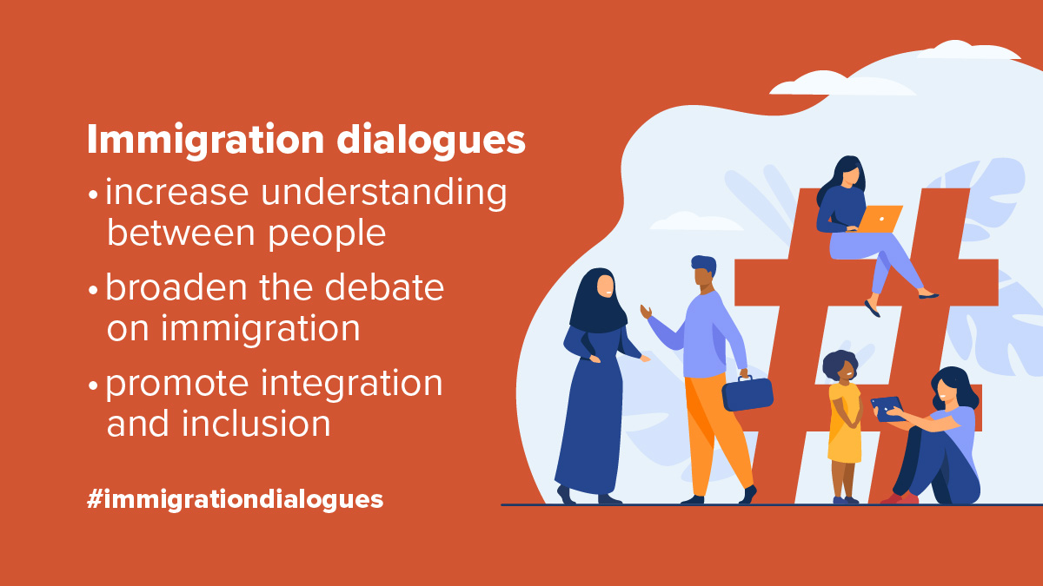

Slide 16


